Slide 1
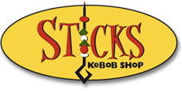
Segmentation at Sticks Kebob Shop

Slide 2
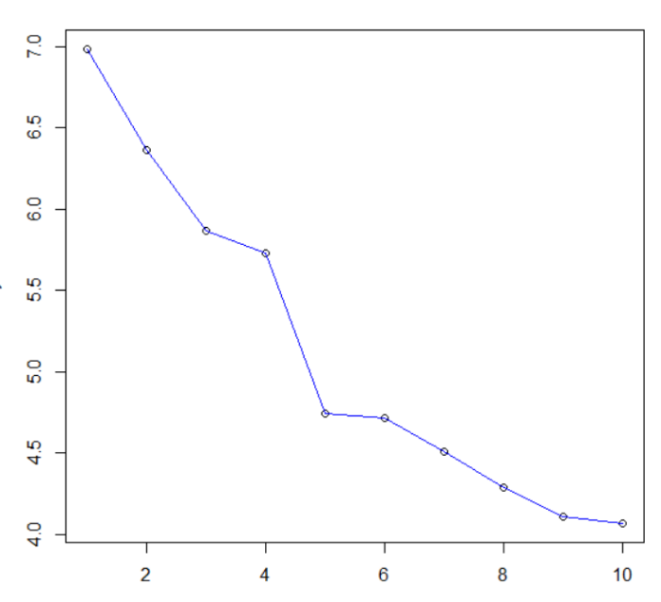
Elbow Plot
3 Segments?
5 Segments?

Slide 3
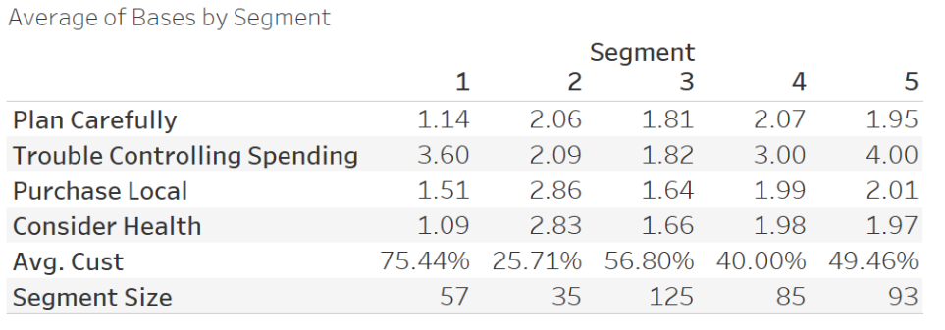
5 Segments?

Slide 4
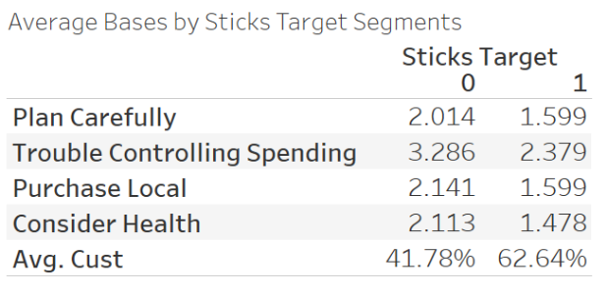
5 Segments?

Slide 5
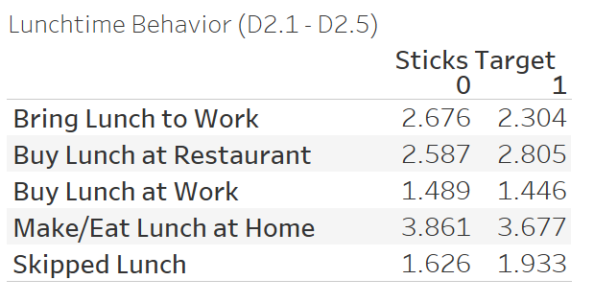
Lunchtime Behavior?
TAKEAWAYS: Sticks customers frequently ate lunch at home or purchased lunch at a restaurant. They were not likely to buy lunch at work.

Slide 6
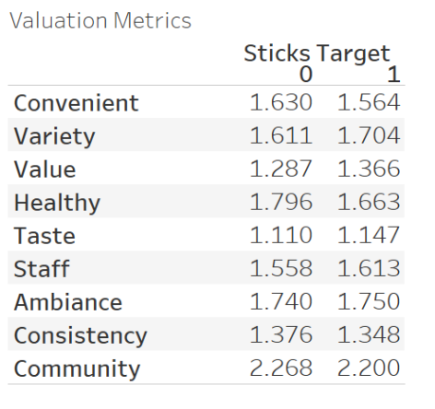
Valuation Metrics
TAKEAWAYS: Sticks Customers are not that much different from non-customers with regard to valuation metrics
NOTE: Higher numbers indicate decreased importance for each metric in the figure (i.e., the lower the number, the more important the metric is).

Slide 7
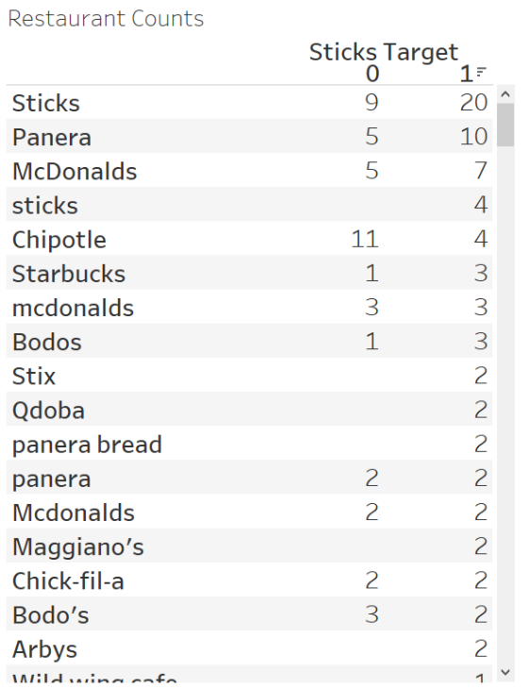
Top Restaurants Visited
TAKEAWAYS: Survey takers either are not good at spelling or use very different capitalizations
Non-Sticks Target | Sticks Target
McDonalds | Panera
Panera | Subway
Olive Garden | Chipotle

Slide 8
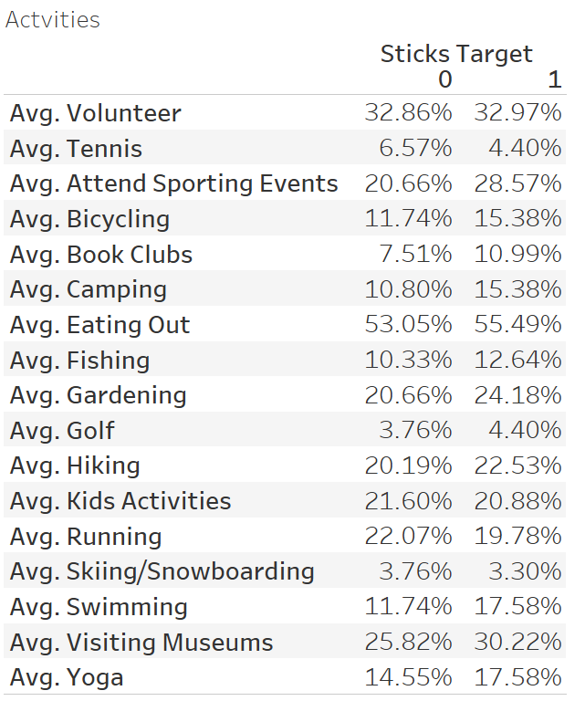
Activities They Participate In
TAKEAWAYS: Sticks target segments are likely to volunteer, attend sporting events, garden, go hiking, attend kids’ activities, and visit museums.

Slide 9
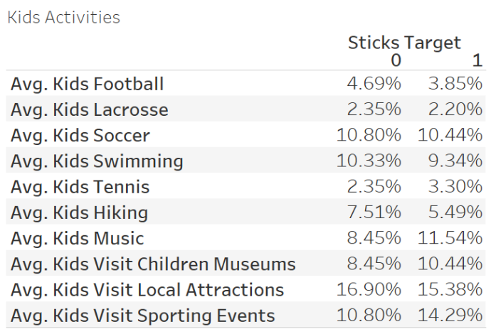
What About Kids’ Activities?
TAKEAWAYS: Sticks target segment with kids is likely to visit local attractions, children’s museums, children’s sporting events, soccer/swimming

Slide 10
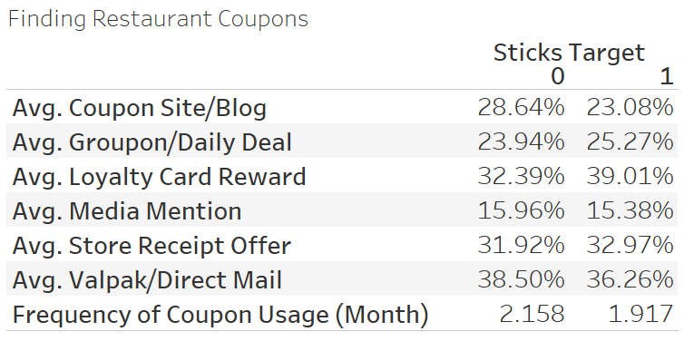
Couponing Behavior
TAKEAWAYS: Sticks target segment are not likely to use coupons, but tend to use those from loyalty programs, store receipts, or Valpak/direct mail

Slide 11
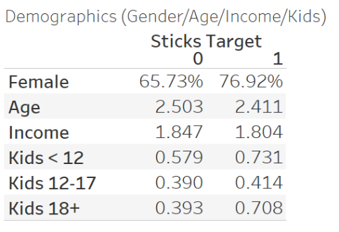
Demographics (Gender/Age/Income/Kids)
TAKEAWAYS: Sticks target group includes more female survey takers who have more young or older kids

Slide 12
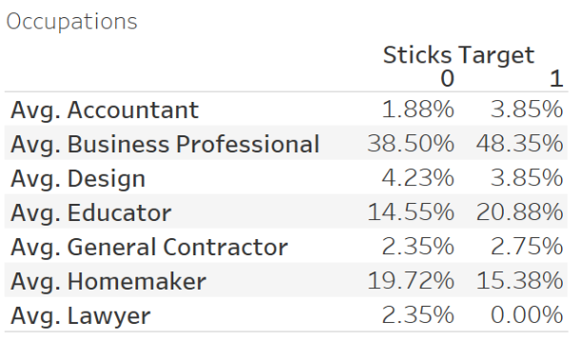
Demographics (Occupation)
TAKEAWAYS: Sticks target are likely to be business professionals, educators, or homemakers (so are non-customers)

Slide 13
Some Conclusions
Sticks management is more likely to find customers among those who value local and healthy food than those who do not.
The challenge for Sticks is that demographics and occupation do not differentiate highly between the restaurant’s target segment and others.
The analysis does not fully support the notion that Sticks’ major consumers are “soccer moms.” A large portion of Sticks customers are also people who go from work to the restaurant for lunch and do not have kids.
Sticks may consider sponsoring local kids’ activities besides soccer such as swimming events, and local sporting events as an efficient way to communicate with its target consumers.

Slide 14
Where to go?
While not a perfect predictor, Locations C and D seem to be better bets for Sticks among the provided options because both include the up-and-comers and white-picket-fences groups.
In addition to these locations, Sticks should collect information on density of offices closer to these locations.
A strategy of locating close to offices and targeting consumers with emotional messages in local sporting events may be the best strategy based on the segmentation analysis.

Slide 15
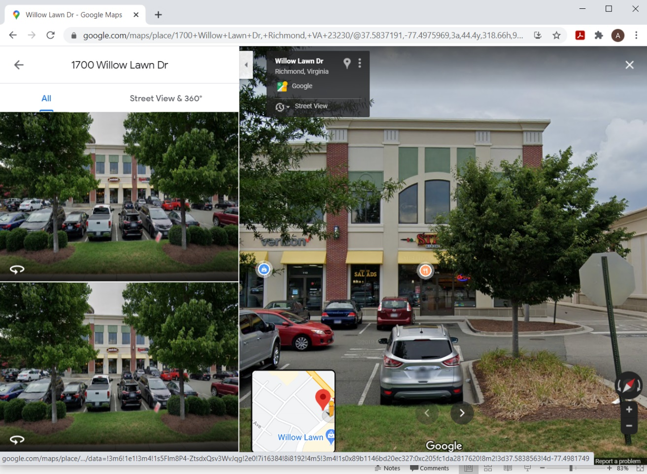
Where Did Sticks Locate?
Location: 1700 Willow Lawn Dr
Richmond, VA 23230

